Slide 1
Huggies DRD
February 2023

Slide 2
Spend Summary by Platform
Total Spends for Active Baby and Newborn |  |  | Spends Contribution
Media Tactic Spends (ZAR) | MAT 21 | MAT 22 | MAT 21 | MAT 22
TV | 13,037,290 | 8,168,979 | 69% | 98%
FB & IG | 1,759,736 | 64,471 | 9% | 0.7%
Video | 1,834,551 | 33,357 | 10% | 0.3%
Display | 1.013,249 | 37,156 | 5% | 0.5%
Search | 1,246,532 | 37,156 | 7% | 0.5%
Total | 18,891,358 | 8,341,119 | 100% | 100%
Source: KCC Media data
Note: MAT 21- Oct 2020 to Sept 2021, MAT 22- Oct 2021 to Sept 2022
© Analytic Edge Proprietary and Confidential

Slide 3
Spend chart for Active Baby, Newborn and Extra Care.
 | Active Baby |  | Newborn |  | Extra Care |  | Total Spends for Active Baby , New born and Extra Care
Media Tactic Spends (ZAR) | MAT 21 | MAT 22 | MAT 21 | MAT 22 | MAT 21 | MAT 22 | MAT 21 | MAT 22
TV | 3,886,440 | 8,168,979 | 9,150,850 | 0 | 1,592,638 | 6,427,093 | 14,629,928 | 14,596,072
FB & IG | 1,116,037 | 64,471 | 643,700 | 0 | 787,264 | 1,951,116 | 2,547,001 | 2,015,587
Video | 714,710 | 33,357 | 1,119,781 | 0 | 151,606 | 269,702 | 1,986,097 | 303,059
Display | 418,383 | 37,156 | 594,866 | 0 | 423,207 | 663,835 | 1,436,456 | 700,991
Search | 403,109 | 37,156 | 843,423 | 0 | 423,207 | 663,835 | 1,669,739 | 700,991
OOH | 0 | 0 | 232,799 | 0 | 0 | 0 | 232,799 | 0
Print | 0 | 0 | 132,563 | 0 | 0 | 0 | 132,563 | 0
Total | 6,538,679 | 8,341,119 | 12,717,982 | 0 | 3,377,922 | 9,975,581 | 22,634,583 | 18,316,700
Source: KCC Media data
Note: MAT 21- Oct 2020 to Sept 2021, MAT 22- Oct 2021 to Sept 2022
Powered by Analytic-edge

Slide 4
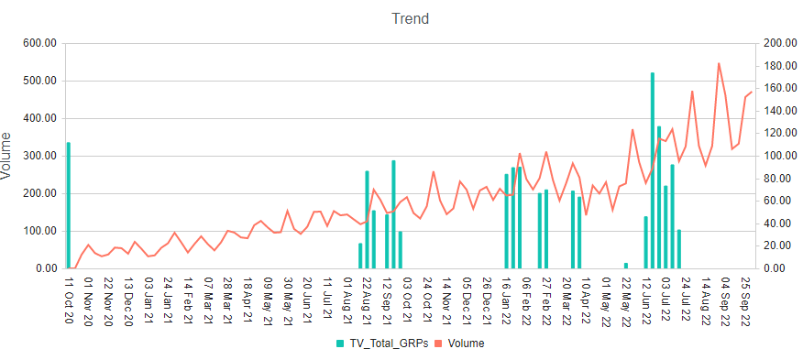
Active Baby - TV GRP’s vs Volume
MAT 22 shows an increase in GRPs and Spends as compared to MAT 21
GRPs
Platform | GRPs |  | Spends(ZAR) |  | CPP
 | MAT 21 | MAT 22 | MAT 21 | MAT 22 | MAT 21 | MAT 22
TV | 447 | 1,080 | 3,886,440 | 8,168,979 | 8,704 | 7,567
+142%
+110%
-13%
Source: KCC Media data
Note: MAT 21- Oct 2020 to Sept 2021, MAT 22- Oct 2021 to Sept 2022
Powered by Analytic-edge

Slide 5
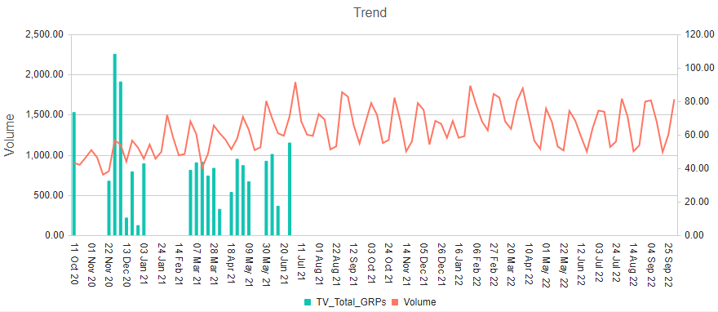
Newborn - TV GRPs vs Volume
Sparse execution over the time period
GRPs
Platform | GRP’s |  | Spends(ZAR) |  | CPP
 | MAT 21 | MAT 22 | MAT 21 | MAT 22 | MAT 21 | MAT 22
TV | 928 | 0 | 9,150,850 | 0 | 9,861 | 0
- 100%
- 100%
-100%
Source: KCC Media data
Note: MAT 21- Oct 2020 to Sept 2021, MAT 22- Oct 2021 to Sept 2022
Powered by Analytic-edge

Slide 6
Extra Care - TV GRPs vs Volume
Spending on TV has increased significantly in MAT 22
Platform | GRP’s |  | Spends(ZAR) |  | CPP
 | MAT 21 | MAT 22 | MAT 21 | MAT 22 | MAT 21 | MAT 22
TV | 278 | 1,399 | 1,592,638 | 6,427,093 | 5,721 | 4,594
+403%
+304%
-20%
Source: KCC Media data
Note: MAT 21- Oct 2020 to Sept 2021, MAT 22- Oct 2021 to Sept 2022
Powered by Analytic-edge

Slide 7
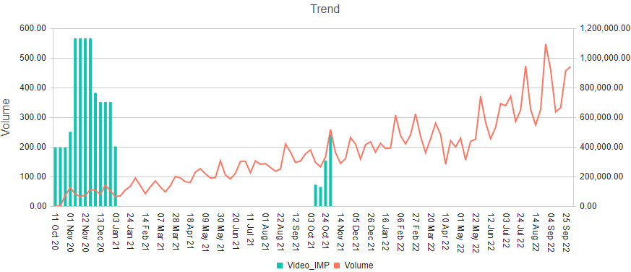
Active Baby - Video Impressions vs Volume
MAT 22 executions were maintained despite a 95% decrease in Video spending.
IMPs
Platform | Impressions |  | Spends(ZAR) |  | CPM
 | MAT 21 | MAT 22 | MAT 21 | MAT 22 | MAT 21 | MAT 22
Video | 9,464,389 | 1,054,630 | 714,770 | 33,357 | 75,522 | 31,629
- 89%
-95%
-58%
Source: KCC Media data
Note: MAT 21- Oct 2020 to Sept 2021, MAT 22- Oct 2021 to Sept 2022, CPM – Cost/MM Imps
Powered by Analytic-edge

Slide 8
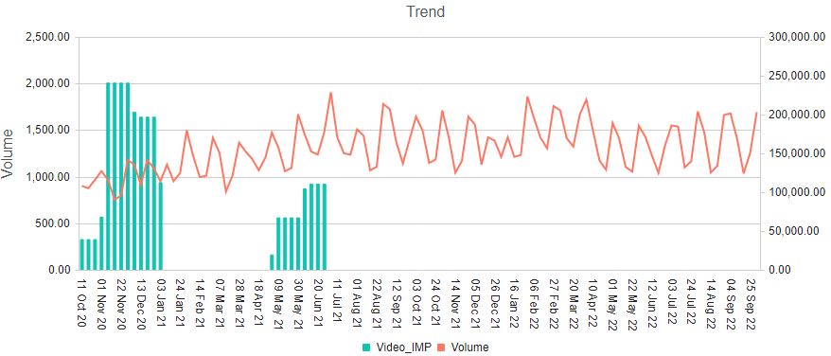
Newborn Baby - Video Impressions vs Volume
MAT 22 executions were increased despite a 79% decrease in their spending.
IMPs
Platform | Impressions |  | Spends(ZAR) |  | CPM
 | MAT 21 | MAT 22 | MAT 21 | MAT 22 | MAT 21 | MAT 22
Video | 2,774,958 | 0 | 1,119,781 | 0 | 403,531 | 0
-100%
-100%
- 100%
Source: KCC Media data
Note: MAT 21- Oct 2020 to Sept 2021, MAT 22- Oct 2021 to Sept 2022, CPM – Cost/MM Imps
Powered by Analytic-edge

Slide 9
Extra Care - Video Imps
Extra care video execution only during MAT 22
Platform | Impressions |  | Spends(ZAR) |  | CPP
 | MAT 21 | MAT 22 | MAT 21 | MAT 22 | MAT 21 | MAT 22
Video | 4,506,496 | 13,571,558 | 151,606 | 269,702 | 33,642 | 19,873
+200%
+78%
- 41%
Source: KCC Media data
Note: MAT 21- Oct 2020 to Sept 2021, MAT 22- Oct 2021 to Sept 2022
Powered by Analytic-edge

Slide 10
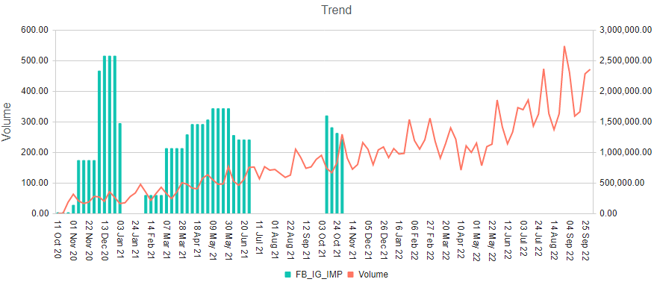
Active Baby - FB (Paid Social) Impressions vs Volume
Facebook execution has decreased significantly in MAT 22
IMPs
Platform | Impressions |  | Spends(ZAR) |  | CPM
 | MAT 21 | MAT 22 | MAT 21 | MAT 22 | MAT 21 | MAT 22
FB | 39,444,587 | 5,512,959 | 1,116,037 | 64,471 | 28,294 | 11,694
-86%
- 94%
-59%
Source: KCC Media data
Note: MAT 21- Oct 2020 to Sept 2021, MAT 22- Oct 2021 to Sept 2022, CPM – Cost/MM Imps
Powered by Analytic-edge

Slide 11
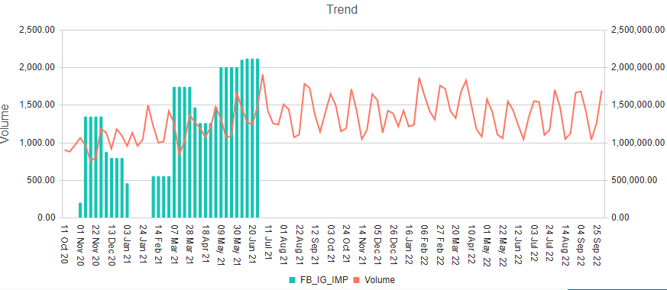
Newborn Baby - FB (Paid Social) Impressions vs Volume
Sparse executions over the time period
IMPs
Platform | Impressions |  | Spends(ZAR) |  | CPM
 | MAT 21 | MAT 22 | MAT 21 | MAT 22 | MAT 21 | MAT 22
FB | 41,456,376 | 0 | 1,116,037 | 0 | 15,527 | 0
- 100%
- 100%
- 100%
Source: KCC Media data
Note: MAT 21- Oct 2020 to Sept 2021, MAT 22- Oct 2021 to Sept 2022, CPM – Cost/MM Imps
Powered by Analytic-edge

Slide 12
Extra Care – FB (Paid Social) Imps
FB(Paid social) executed only during MAT 22 time period
Platform | Impressions |  | Spends(ZAR) |  | CPM
 | MAT 21 | MAT 22 | MAT 21 | MAT 22 | MAT 21 | MAT 22
FB | 53,543,263 | 138,722,078 | 787,264 | 1,951,116 | 14,703 | 14,065
+159%
+147%
- 4%
Source: KCC Media data
Note: MAT 21- Oct 2020 to Sept 2021, MAT 22- Oct 2021 to Sept 2022
Powered by Analytic-edge

Slide 13
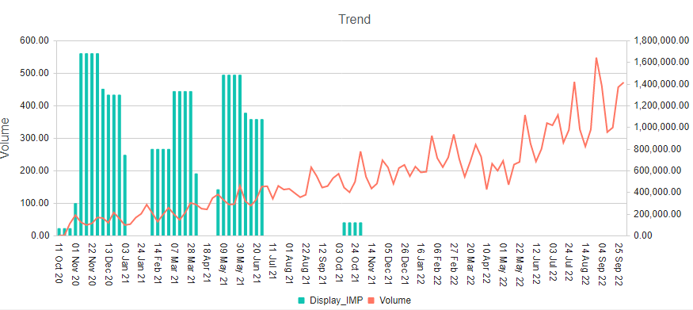
Active Baby - Display Impressions vs Volume
Executions have been decreased by 99% in MAT 22.
IMPs
Platform | Impressions |  | Spends(ZAR) |  | CPM
 | MAT 21 | MAT 22 | MAT 21 | MAT 22 | MAT 21 | MAT 22
Display | 32,923,710 | 470,068 | 418,383 | 37,156 | 12,708 | 79,044
-99%
-91%
+522%
Source: KCC Media data
Note: MAT 21- Oct 2020 to Sept 2021, MAT 22- Oct 2021 to Sept 2022
CPM is Cost / MM IMPs
Powered by Analytic-edge

Slide 14
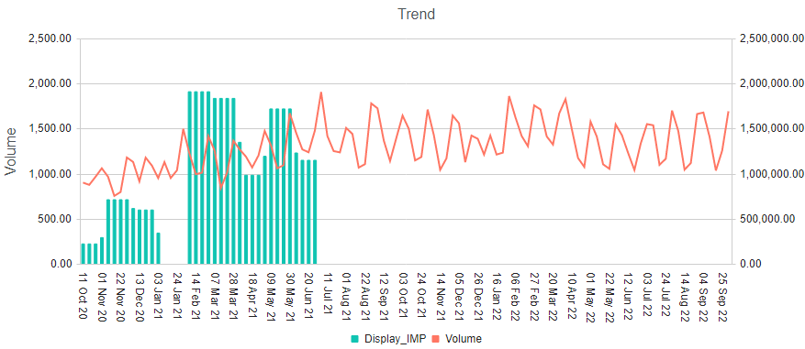
Newborn – Display Impressions vs Volume
Sparse execution over the time period
IMPs
Platform | Impressions |  | Spends(ZAR) |  | CPM
 | MAT 21 | MAT 22 | MAT 21 | MAT 22 | MAT 21 | MAT 22
Display | 38,560,804 | 0 | 594,866 | 0 | 15,427 | 0
Source: KCC Media data
Note: MAT 21- Oct 2020 to Sept 2021, MAT 22- Oct 2021 to Sept 2022
Powered by Analytic-edge

Slide 15
Extra Care – Display Imps
There is 57% increase in spending in MAT 22 compared to MAT 21
Platform | Impressions |  | Spends(ZAR) |  | CPM
 | MAT 21 | MAT 22 | MAT 21 | MAT 22 | MAT 21 | MAT 22
Display | 23,918,539 | 25,686,461 | 423,207 | 663,835 | 17,694 | 25,844
+7%
+57%
+46%
Source: KCC Media data
Note: MAT 21- Oct 2020 to Sept 2021, MAT 22- Oct 2021 to Sept 2022
Powered by Analytic-edge

Slide 16
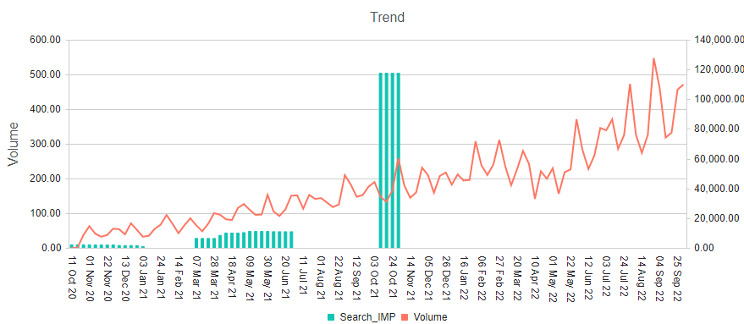
Active Baby - Search Impressions vs Volume
Despite a decrease in spending, Search impressions increased in MAT 22 by 154%
IMPs
Platform | Impressions |  | Spends(ZAR) |  | CPM
 | MAT 21 | MAT 22 | MAT 21 | MAT 22 | MAT 21 | MAT 22
Search | 185.063 | 470,068 | 403,109 | 37,156 | 2,178,229 | 79,044
+154%
-91%
-96%
Source: KCC Media data
Note: MAT 21- Oct 2020 to Sept 2021, MAT 22- Oct 2021 to Sept 2022, CPM – Cost/MM Imps
Powered by Analytic-edge

Slide 17
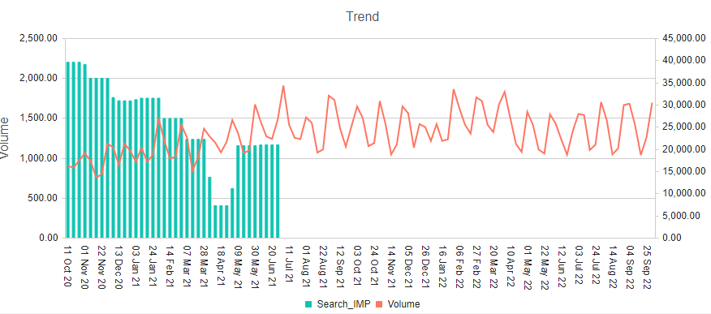
Newborn- Search Impressions vs Volume
MAT 22 executions were maintained despite a 48% decrease in search spending.
IMPs
Platform | Impressions |  | Spends(ZAR) |  | CPM
 | MAT 21 | MAT 22 | MAT 21 | MAT 22 | MAT 21 | MAT 22
Search | 992,042 | 0 | 843,423 | 0 | 850,188 | 0
Source: KCC Media data
Note: MAT 21- Oct 2020 to Sept 2021, MAT 22- Oct 2021 to Sept 2022, CPM – Cost/MM Imps
Powered by Analytic-edge

Slide 18
Extra Care – Search Imps
For extra care, Search spends have increased in MAT 22 by 57%
Platform | Impressions |  | Spends(ZAR) |  | CPM
 | MAT 21 | MAT 22 | MAT 21 | MAT 22 | MAT 21 | MAT 22
Search | 23,918,539 | 25,686,461 | 423,207 | 663,835 | 17,694 | 25,844
+7%
+57%
+46%
Source: KCC Media data
Note: MAT 21- Oct 2020 to Sept 2021, MAT 22- Oct 2021 to Sept 2022
Powered by Analytic-edge

Slide 19
Total Huggies (Website, Organic Search, Organic Social, Emails)
Powered by Analytic-edge

Slide 20
Total Huggies- Website Sessions
Platform | Impressions
 | MAT 21 | MAT 22
Website Sessions | 599,267 | 594,727
-1%
Source: KCC Media data
Note: MAT 21- Oct 2020 to Sept 2021, MAT 22- Oct 2021 to Sept 2022
Powered by Analytic-edge

Slide 21
Total Huggies- Organic Search
Platform | Impressions
 | MAT 21 | MAT 22
Organic Search | 8,951,021 | 281,440
-97%
Source: KCC Media data
Note: MAT 21- Oct 2020 to Sept 2021, MAT 22- Oct 2021 to Sept 2022
Powered by Analytic-edge

Slide 22
Total Huggies- Organic Social
Platform | Impressions
 | MAT 21 | MAT 22
Organic Social | 1,210,427 | 593,724
-51%
Source: KCC Media data
Note: MAT 21- Oct 2020 to Sept 2021, MAT 22- Oct 2021 to Sept 2022
Powered by Analytic-edge

Slide 23
Total Huggies- Emails
Platform | Emails
 | MAT 21 | MAT 22
Emails send | 112,420 | 125,058
+11%
Source: KCC Media data
Note: MAT 21- Oct 2020 to Sept 2021, MAT 22- Oct 2021 to Sept 2022
Powered by Analytic-edge

Slide 24
Powered by Analytic-edge

